Slide 1

VLMS Express
Lean, simplified digital validation.
Holly Reynolds
November 2022

Slide 2
Topics
Today’s presentation
Common challenges of today’s validation
Going from paper to glass
A brief overview of VLMS Express
3-week deployment
Wrap-up

Slide 3




Common issues of today’s validation
Cost of consultants
Non-integrated tools
Version control and retrieval
Slow, costly audit prep
Notes:
Bottom line:
Slow, linear, costly, dreaded, unnecessarily difficult

Slide 4

VLMS Express
Lean. Simplified. Cloud-based.
Digital validation for everyone.

Slide 5

Taking validation from paper to glass
Convert paper-based processes to 100% digital
Get up and running in less than four weeks
Author, execute, capture, route and trace in the app
Deploy in the cloud for minimal IT burden

Slide 6
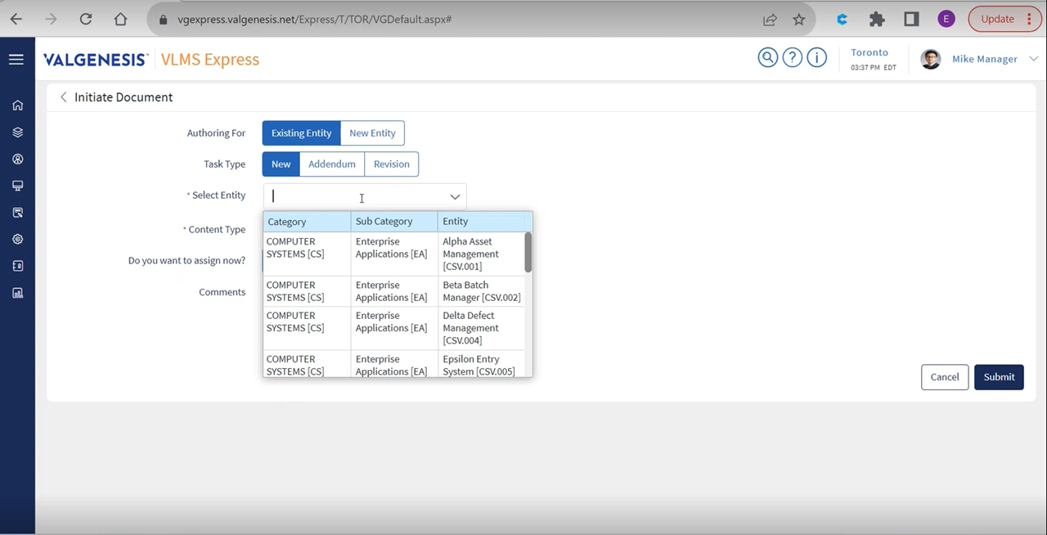
Intuitive and flexible authoring
Notes:
Express has unparalleled flexibility to allow authoring within the system.
Here you can see we can initiate for an existing entity, or start with a new entity, adding new tasks, appending or even revising tasks. All without engaging a consultant.

Slide 7
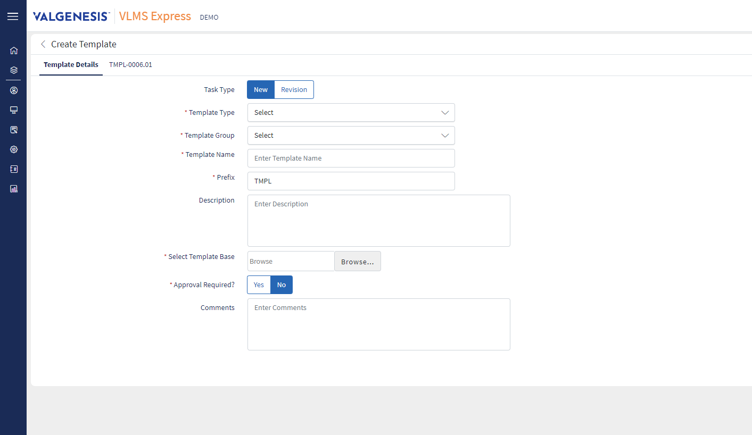
Easy upload and use of existing templates
Notes:
Express has unparalleled flexibility to allow authoring within the system.
Here you can see we can initiate for an existing entity, or start with a new entity, adding new tasks, appending or even revising tasks. All without engaging a consultant.

Slide 8
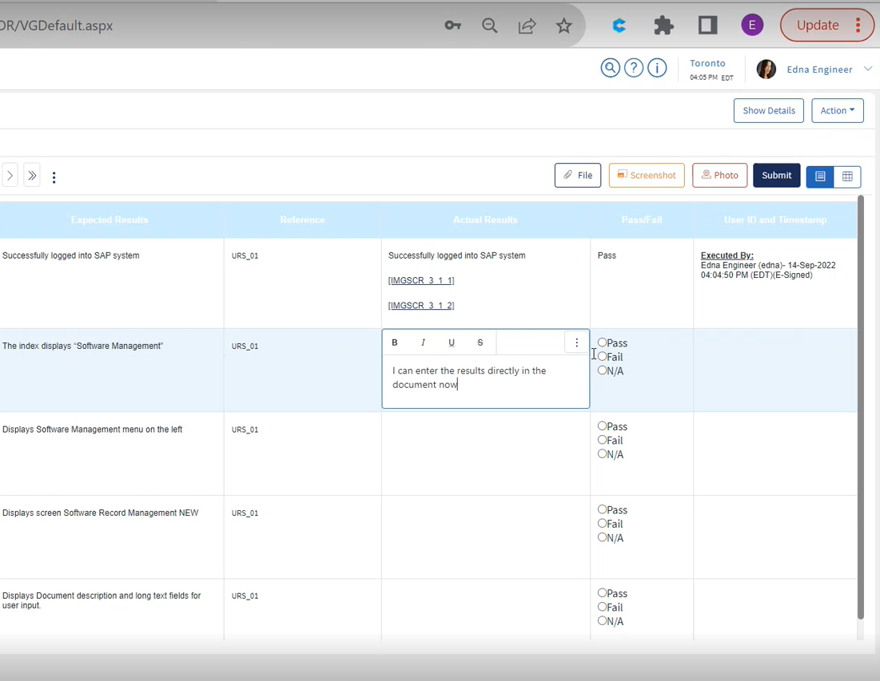
Execute directly within the protocol document

Slide 9
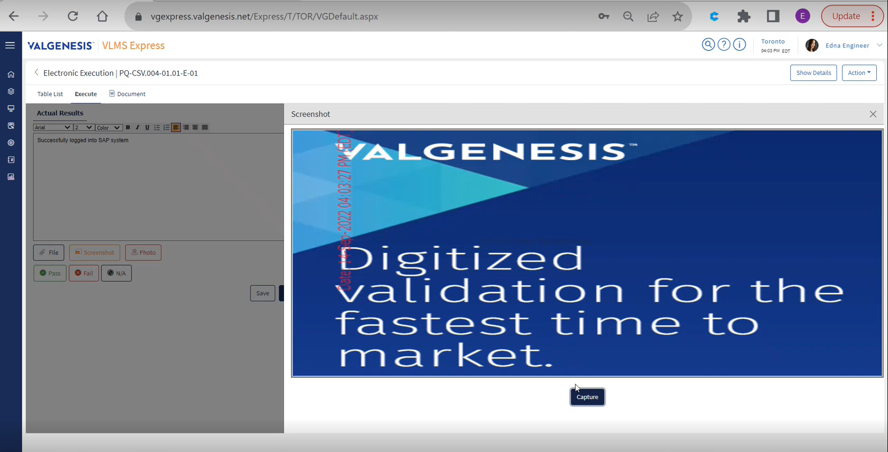
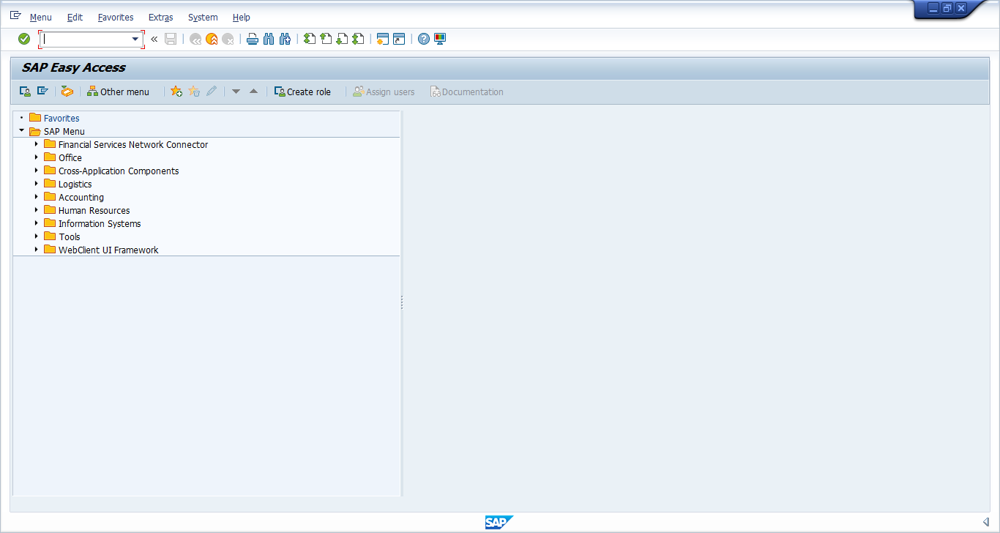
Simplified
screen and photo capture with watermark
Date: 14-Sep-2022 04:03:27 PM (EDT)
Notes:
Capture either full screen shot or use the snip tool to only capture the desired relevant portion of the screen.
You can also capture your objective evidence directly from the device's camera as photo or video evidence.

Slide 10
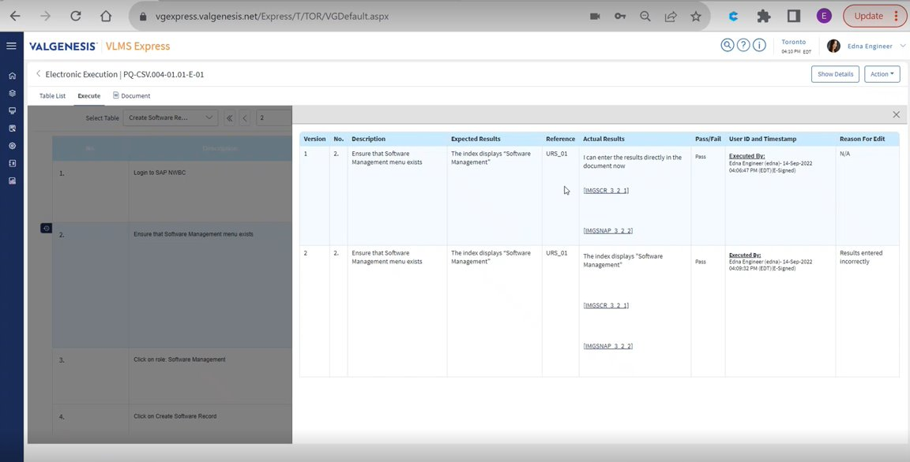
Online editing with immutable tracking
Notes:
Wow your auditor and inspectors with contemporaneous edit tracking and history of execution steps and all modifications, tracked in real time.

Slide 11
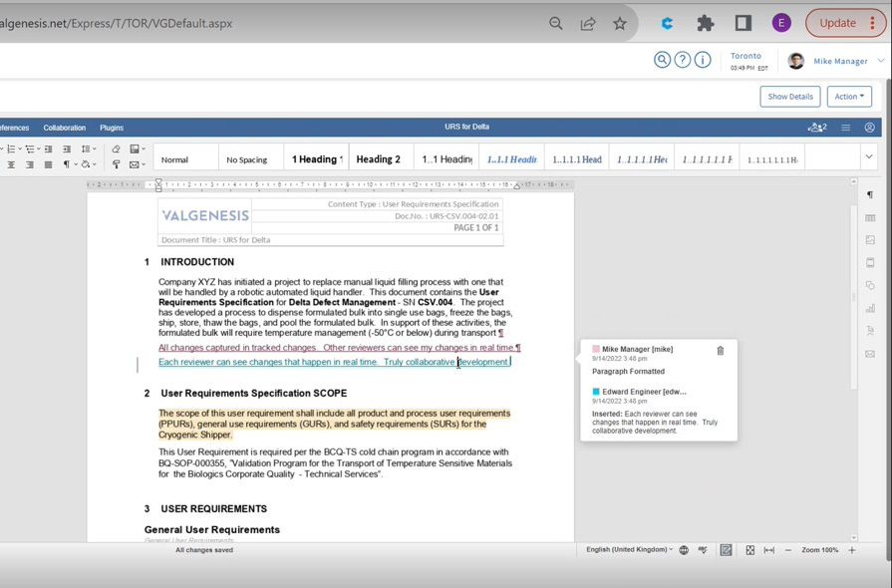
Simultaneous,
real-time review
Notes:
Extreme collaboration is possible with Express.
Save time with split execution along with simultaneous review, where all changes to the document are tracked in real time, with visibility to all online parties.

Slide 12
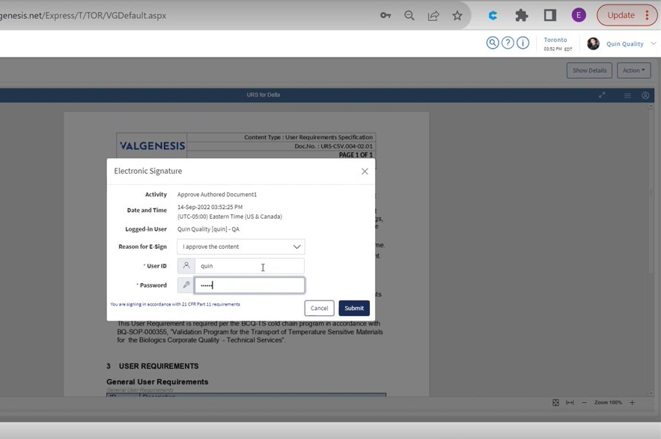
Compliant digital signatures
Notes:
No need for repeated logon, e-signature is configurable to the whole document, or to individual tasks…it’s up to you!

Slide 13
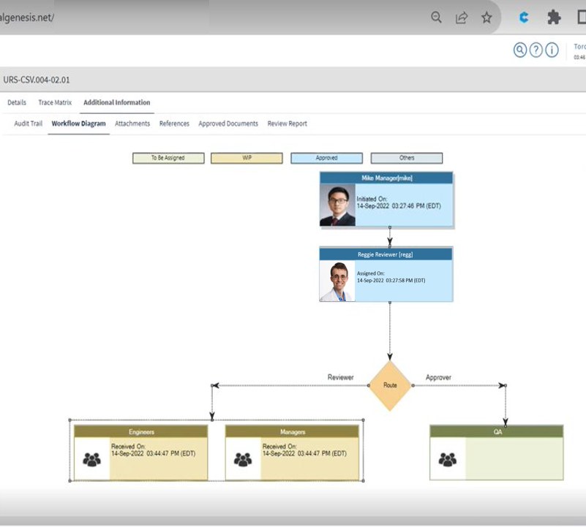
Automated workflow and routing
Notes:
Instant ability to Visualize the workflow to understand who is assigned and at what stage the document is in.

Slide 14
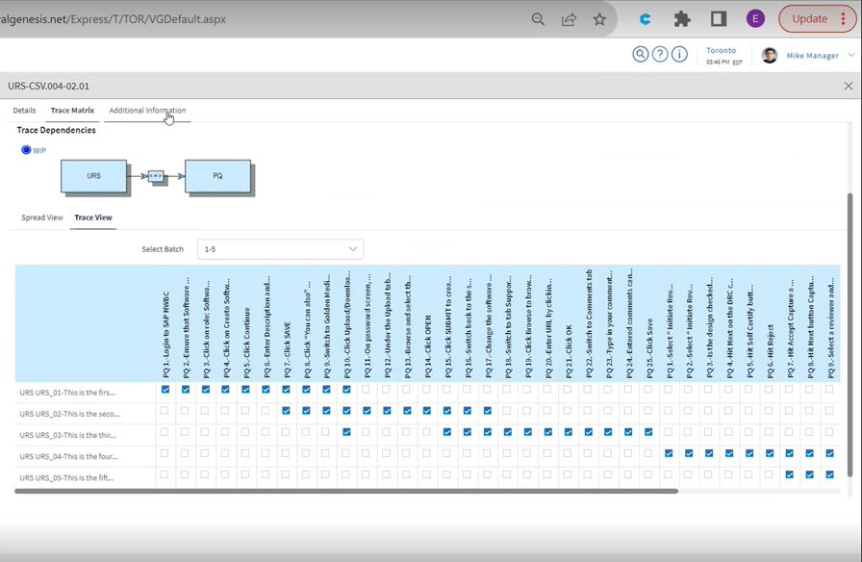
Auto-generated traceability matrices
Notes:
No more excel headaches…the Requirements Traceability Matrix (RTM) is automatically created and dynamically updated throughout the execution.

Slide 15
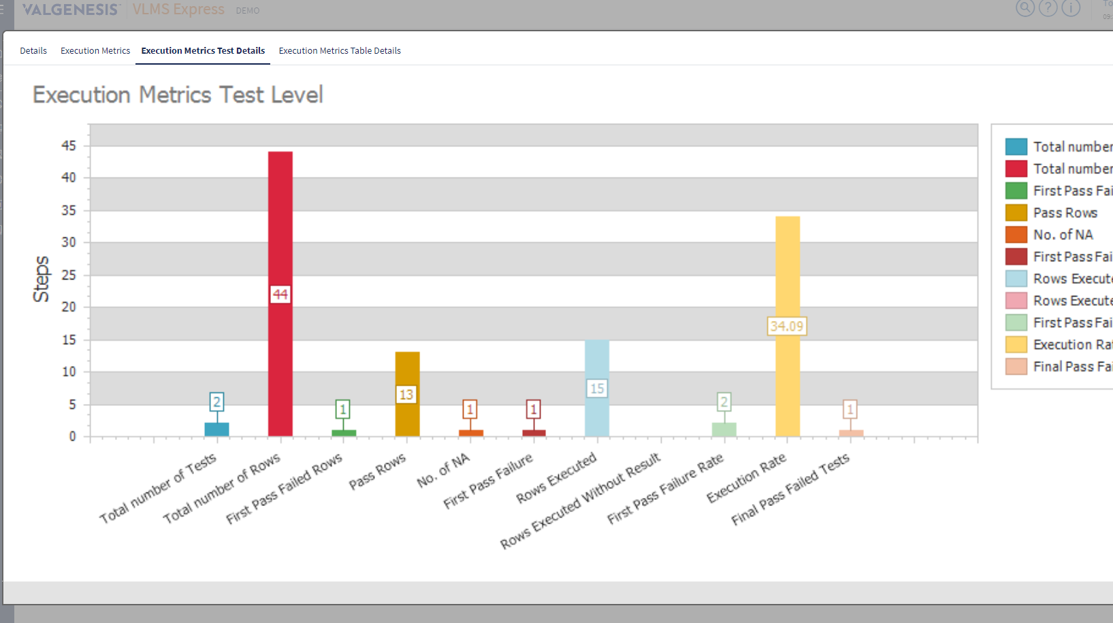
Standard and
ad hoc reporting
Notes:
Valuable reporting capabilities within the system without needing to export the data.
Although, you can export for other reporting needs.

Slide 16


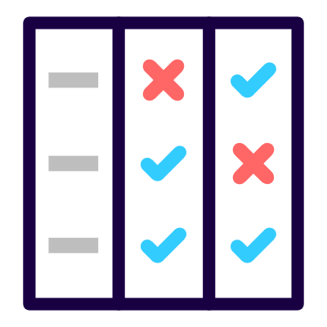
Purpose-built digital validation for CSV and more
Intuitive and flexible authoring
Leverage existing templates
Execute directly in the document
Simplified screen and photo capture
Online editing with immutable tracking
Simultaneous, real-time review
Compliant digital signatures
Automated workflow and routing
Auto-generated traceability matrices
Standard and ad hoc reporting
Out-of-the-box:
Computer System
Validation
Equipment
Validation
Commissioning
& Qualification

Slide 17
Designed with you in mind

Slide 18

Pre-market Biotech
Express can handle all your CSV, equipment, and instrument validation needs
Adherence to ALCOA+ data integrity principles
Always inspection ready
Notes:
Start digital, stay digital.
Validate your equipment, instruments, facilities and computer software
Adherence to ALCOA+ data integrity principles
Always audit and inspection ready with a few clicks
Express implements a secure, durable validation technology that helps to eliminate the frustrations that impact your time to patient.
Provide device specific validation packages, in a convenient digital format.
Leveraging a best-in-class, easy to deploy CSV solution
Clear, organized and fully digital records to simplify audits, inspections and any due diligence.

Slide 19
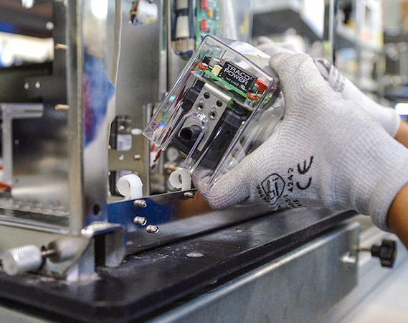
Mid-Sized Med Device Mfg
Secure, durable validation technology
Eliminate impacts on time to patient
Stand out with elegant digital validation packages
Digital, compliant CSV
Notes:
Start digital, stay digital.
Validate your equipment, instruments, facilities and computer software
Adherence to ALCOA+ data integrity principles
Always audit and inspection ready with a few clicks
Express implements a secure, durable validation technology that helps to eliminate the frustrations that impact your time to patient.
Provide your clients device specific validation packages, in a convenient digital format.
Leveraging a best-in-class, easy to deploy CSV solution
Clear, organized and fully digital records to simplify audits, inspections and any due diligence.

Slide 20

Medical Software
Fully digital CSV solution
Simplify audits, inspections and due diligence
Provide digital validation packages
Notes:
Start digital, stay digital.
Validate your equipment, instruments, facilities and computer software
Adherence to ALCOA+ data integrity principles
Always audit and inspection ready with a few clicks
Express implements a secure, durable validation technology that helps to eliminate the frustrations that impact your time to patient.
Provide device specific validation packages, in a convenient digital format.
Leveraging a best-in-class, easy to deploy CSV solution
Clear, organized and fully digital records to simplify audits, inspections and any due diligence.

Slide 21
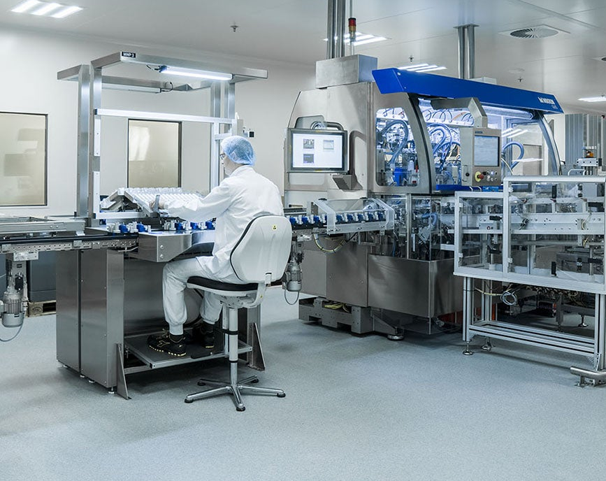
Capitalized Projects
Maximize project budget
Deploy quickly
Retain the data
Control your costs
Ensure inspection readiness
Notes:
Start digital, stay digital.
Validate your equipment, instruments, facilities and computer software
Adherence to ALCOA+ data integrity principles
Always audit and inspection ready with a few clicks
Express implements a secure, durable validation technology that helps to eliminate the frustrations that impact your time to patient.
Provide device specific validation packages, in a convenient digital format.
Leveraging a best-in-class, easy to deploy CSV solution
Clear, organized and fully digital records to simplify audits, inspections and any due diligence.
Capitalized project teams:
Maximize budget utilization on your capital projects.
Controlled expense by activating Express for the project and close it once completed.
You retain all the project data, even after project closure.

Slide 22

Consultants
Maximize Client value
Know and control your costs
Protect Client data
Perfect for CSV Solutions
Notes:
Start digital, stay digital.
Validate your equipment, instruments, facilities and computer software
Adherence to ALCOA+ data integrity principles
Always audit and inspection ready with a few clicks
Express implements a secure, durable validation technology that helps to eliminate the frustrations that impact your time to patient.
Provide device specific validation packages, in a convenient digital format.
Leveraging a best-in-class, easy to deploy CSV solution
Clear, organized and fully digital records to simplify audits, inspections and any due diligence.
Maximize budget utilization on your client projects.
Controlled expense by activating Express for the project and close it once completed.
You retain all the project data, even after project closure.
Deploy Express within your client engagements,
Know your costs
Client Data is separate and secure

Slide 23
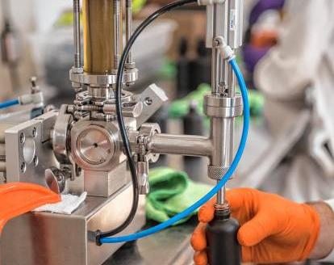
Cannabis Manufacturer
Avoid discarded batches
Perfect for CSV
Maximize budget utilization
Simplify audits and inspections
Notes:
Start digital, stay digital.
Validate your equipment, instruments, facilities and computer software
Adherence to ALCOA+ data integrity principles
Always audit and inspection ready with a few clicks
Express implements a secure, durable validation technology that helps to eliminate the frustrations that impact your time to patient.
Provide device specific validation packages, in a convenient digital format.
Leveraging a best-in-class, easy to deploy CSV solution
Clear, organized and fully digital records to simplify audits, inspections and any due diligence.
Cannabis manufacturers:
Avoid discarded batches with world class validation software that helps you ensure product quality and safety

Slide 24
The value of VLMS Express

Slide 25
The total business benefits
Increase Productivity
Boost Recruiting
Reduce Overhead
Cut at least 50% off time and cost of validation effort
Streamline quality
by enforcing standardization
Replace Excel, Word, DocuSign and DMSs with one validated system of record
Hire remote or offshore employees, work in real time
Deploy modern tools, attract next generation knowledge workers
Eliminate hard paper and storage costs
Prep for audits and inspections in a snap

Slide 26
Simple deployment
Get up and running faster than you thought possible.

Slide 27
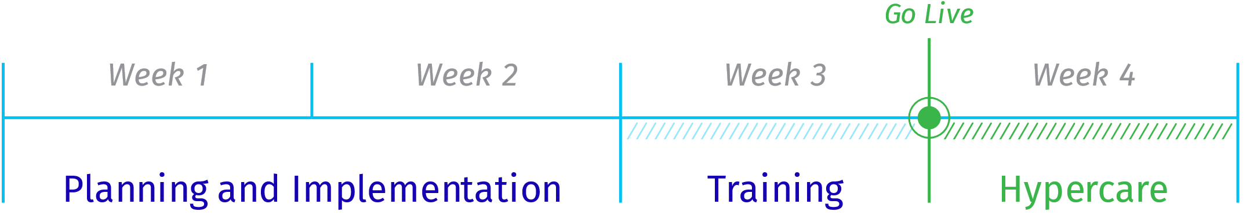

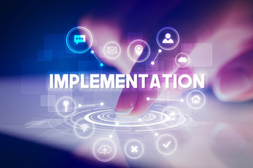


Notes:
With a pre-configured instance, VLMS Express can typically be deployed in as little as 3-4 weeks.
Try doing that with any other solution on the market!

Slide 28
Lean, simplified digital validation
VLMS Express
Unified toolset
Single source of truth
Enforced standardization
Real-time, virtual collaboration
Fast cloud deployment
Major step toward Pharma 4.0

Slide 29
Thank You!

Slide 30
Simplified Pricing
$50,000 annual fixed
Up to 30 named users
$10k per additional “pack” of 10 users
Notes:
Includes 3 weeks of implementation services AND 1 week of Hypercare….these fees are waived and demonstrate VG investment into making sure you are set up for success.
6 months of VG University will also be included (access renewal process and fees TBD)

Slide 31
Where does Express make sense?
CSV
Simple Risk Management
Stable environments
Perfected CSV solution
Decision tree logic included in future release
Change requests not supported
Project Focused Business
English language only
Limited 3rd Party Systems
Separate validation needs
Controlled expenses
Data integrity
English only supported
No need for 3rd party integrations or API’s
Single site
Simplified deployment
Typically, 1-50 users
Notes:
As robust as Express is with its capabilities…VLMS remains THE de facto standard in Validation software.
But how does Express differ from our flagship VLMS product? The primary differences lie in the number of management modules that make the full VLMS product the most comprehensive solution in the market.
Where does Express make sense?
____________________________________________
Side Note for Sales Team:
So…..When should we talk about full VLMS instead of Express?
multi-site support
Change control requests
Need more robust Risk Mgmt
Multi-language support
SSO support needed
Need to integrate with 3rd party systems

Slide 32
Designed For a Variety of Scenarios…
CDMO’s, Startups, Small Orgs
Consulting Firms
Defined Capital Projects
Start Digital, Stay Digital
Be Compliant and Audit Ready
Attract talent with Modern Tools
More time to focus on other business needs
Defined projects
Keep Client data separate and secure
Controlled Expense by Project
Rapid Deployment
Pricing Flexibility
Notes:
Supports Multi-Tenant. Multiple tenants can be created from a master URL and customer data will be segregated in different databases.

Slide 33
What don’t I get compared to VLMS?
Change Management
Multi-Site Functionality
No requirement change requests in Express
Express intended for single site projects
User roles set by project, not by site
Risk Management
Other
No decision tree logic for risk assessment of functional or system level
  *to be added with future release
SSO is not applicable
No multilingual support

Slide 34
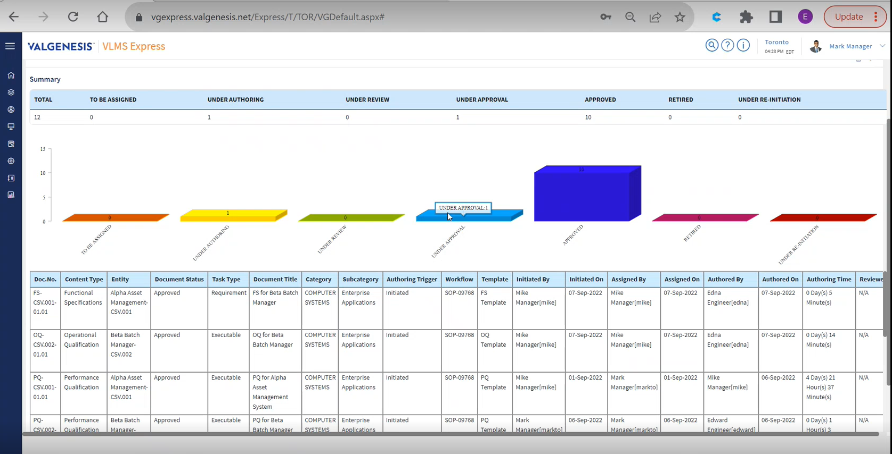
Standard and
ad hoc reporting
Notes:
Valuable reporting capabilities within the system without needing to export the data.
Although, you can export for other reporting needs.

Slide 35


Distinction from full VLMS Platform
 | VLMS Express | VLMS
Multi-site support
Decision Tree Risk Mgmt*
Change Control Requests
Mutli-language support
Single Sign On (SSO) support
API Integration support
* Planned in future release
Notes:
As robust as Express is with its capabilities…VLMS remains THE de facto standard in Validation software.
But how does Express differ from our flagship VLMS product? The primary differences lie in the number of management modules that make the full VLMS product the most comprehensive solution in the market.
Where does Express make sense?
Express is designed for single site projects, reducing the configuration necessary to assign roles and variations of templates.
Currently, the decision tree logic that resides in full VLMS that guides the author to assign the correct level of required validation is not available in Express, and is planned in a future release (TBA)

Slide 36
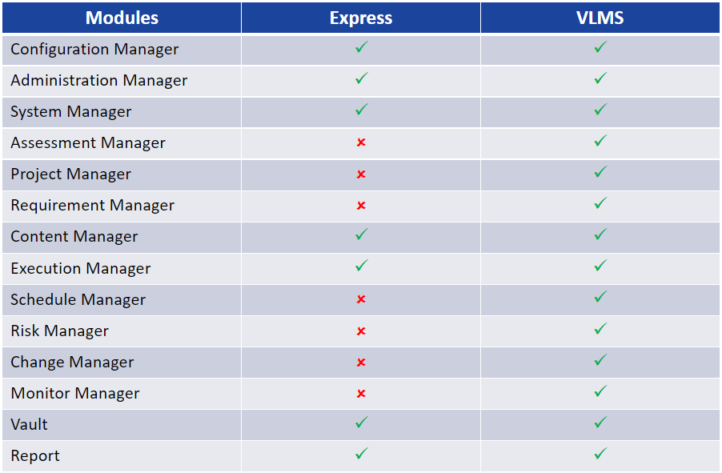
Module List vs VLMS
Notes:
Critical functionality and features are included in this streamlined version of the flagship ValGenesis VLMS solution, giving you a streamlined, easy to deploy digital validation option.

Slide 37
VLMS Express™
Taking you from breakthrough to blockbuster!

Slide 38
Demo

