Slide 1

VLMS Express
Lean. Simplified. Cloud-based.
Digital validation for everyone.

Slide 2
Topics
Today’s presentation
Going from paper to glass
A brief overview of VLMS Express
VLMS vs. VLMS Express
Designed for
Simple deployment
Commercial Model
Value of VLMS Express

Slide 3

Taking validation from paper to glass
Convert paper-based processes to 100% digital
Get up and running in less than four weeks
Author, execute, capture, route and trace in the app
Deploy in the cloud for minimal IT burden

Slide 4
Why did we develop VLMS Express ?
Not all organizations are willing to fully commit to go Digitized Validation, but want to grow into it
Not all organizations need to support all types of validation.

Slide 5
Brief overview of VLMS Express….

Slide 6
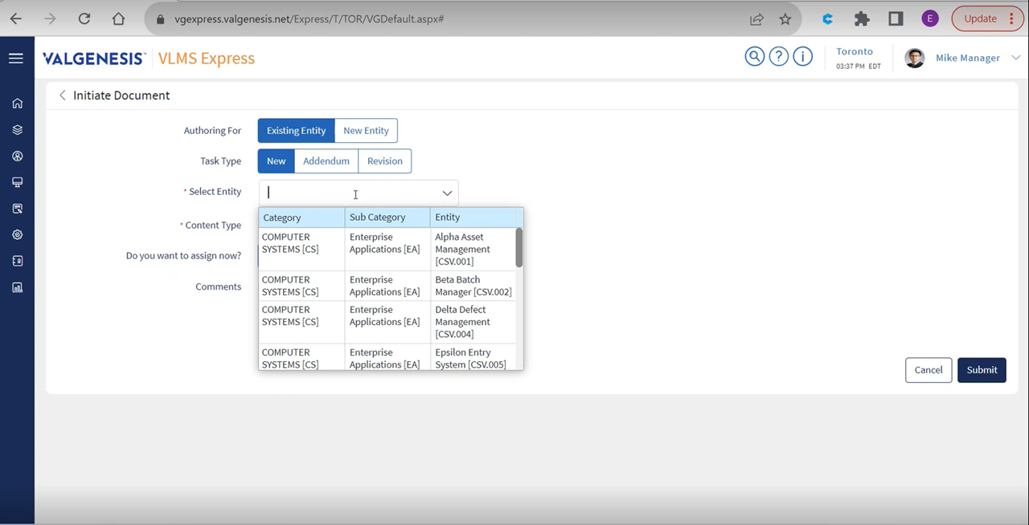
Intuitive and flexible authoring
Notes:
Express has unparalleled flexibility to allow authoring within the system.
Here you can see we can initiate for an existing entity, or start with a new entity, adding new tasks, appending or even revising tasks. All without engaging a consultant.

Slide 7
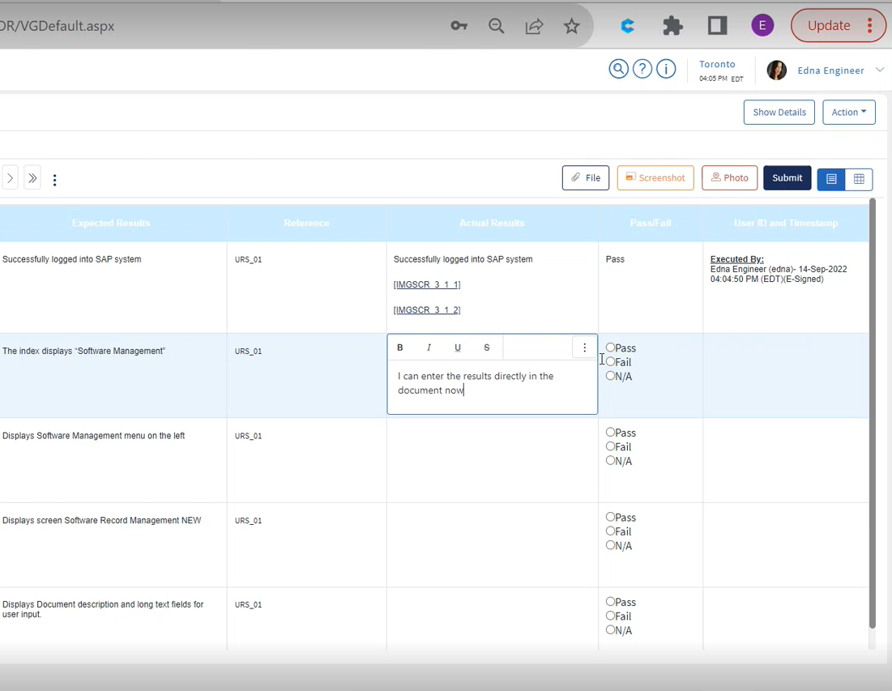
Execute directly within the protocol document

Slide 8
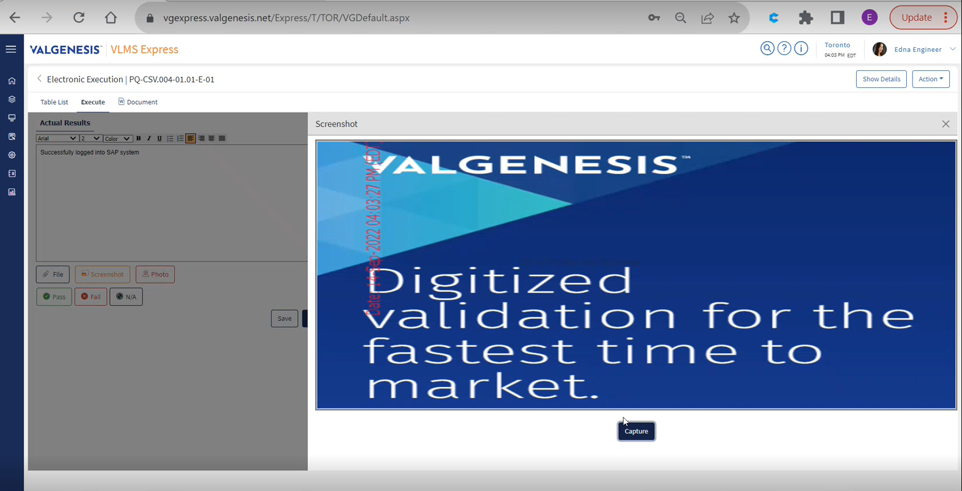
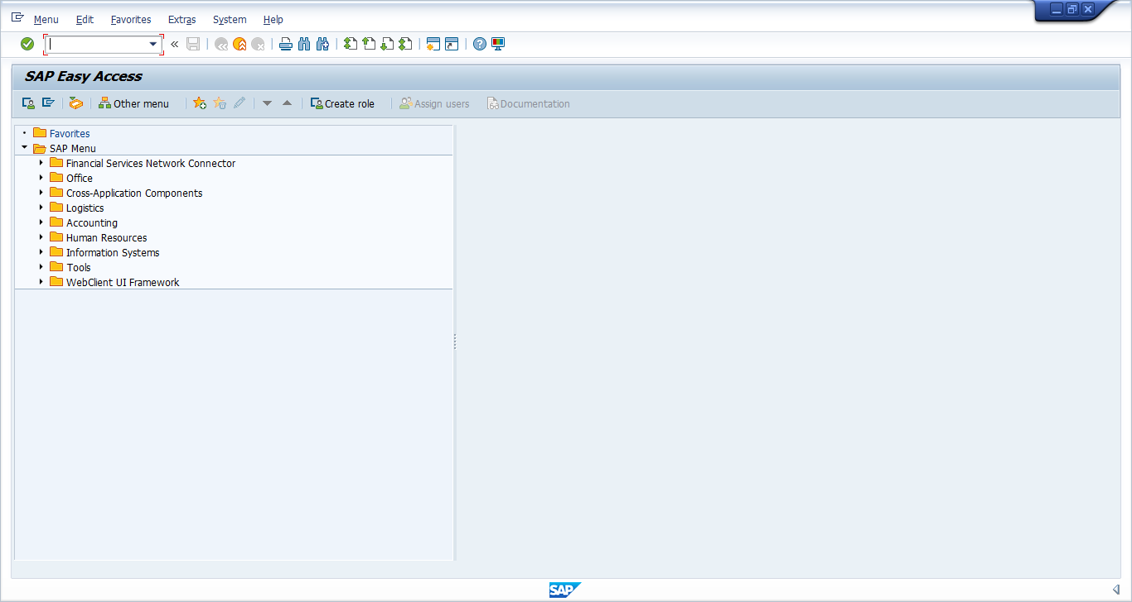
Simplified
screen and photo capture with watermark
Date: 14-Sep-2022 04:03:27 PM (EDT)
Notes:
Capture either full screen shot or use the snip tool to only capture the desired relevant portion of the screen.
You can also capture your objective evidence directly from the device's camera as photo or video evidence.

Slide 9
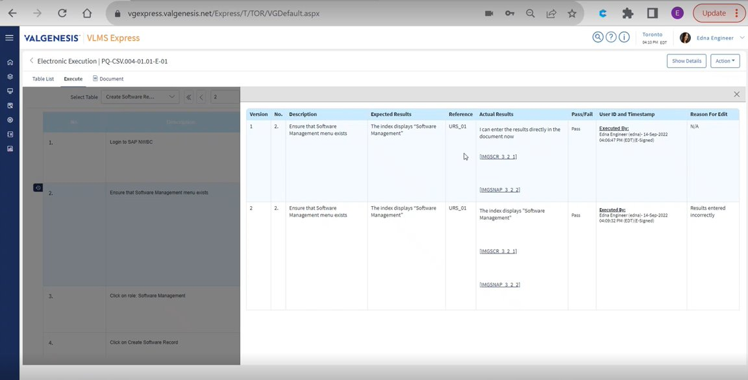
Online editing with an audit trail
Notes:
Wow your auditor and inspectors with contemporaneous edit tracking and history of execution steps and all modifications, tracked in real time.

Slide 10
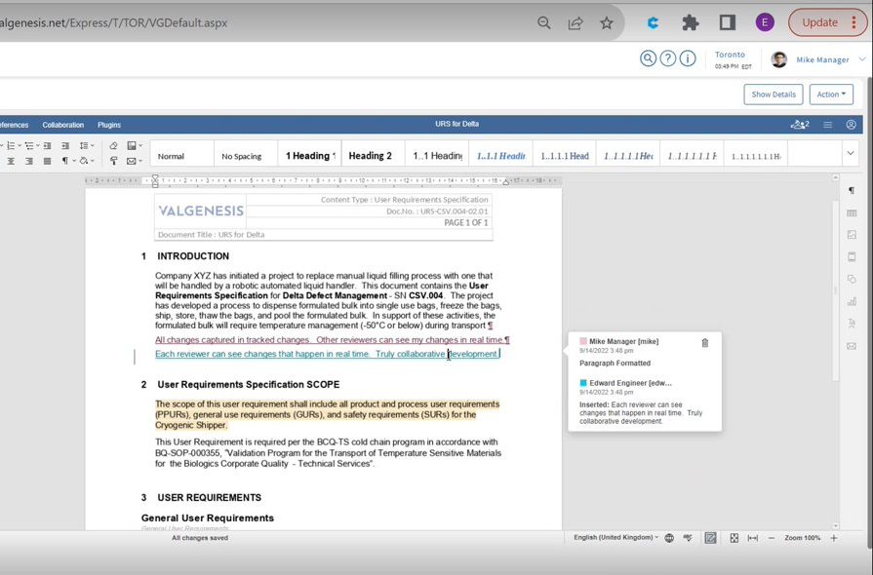
Simultaneous,
real-time review
Notes:
Extreme collaboration is possible with Express.
Save time with split execution along with simultaneous review, where all changes to the document are tracked in real time, with visibility to all online parties.

Slide 11
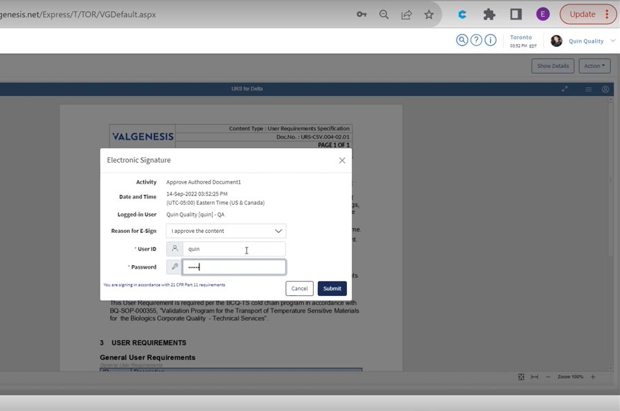
Compliant digital signatures
Notes:
No need for repeated logon, e-signature is configurable to the whole document, or to individual tasks…it’s up to you!

Slide 12
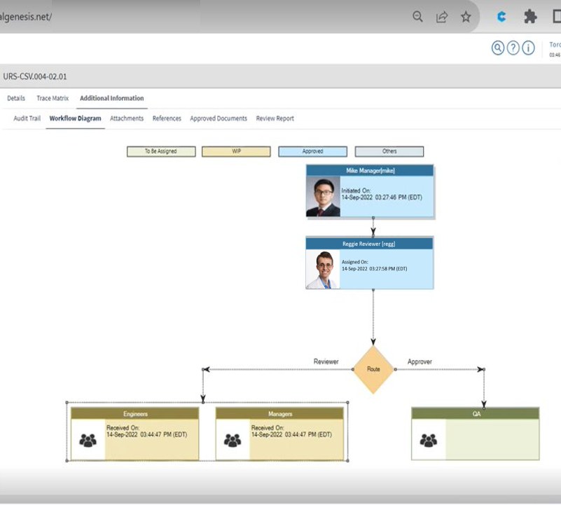
Automated workflow and routing
Notes:
Instant ability to Visualize the workflow to understand who is assigned and at what stage the document is in.

Slide 13
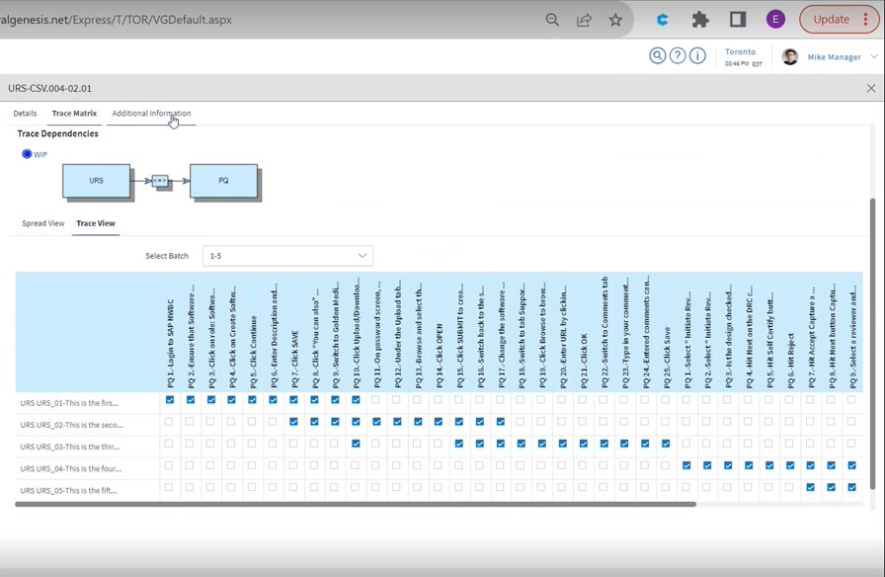
Auto-generated traceability matrices
Notes:
No more excel headaches…the Requirements Traceability Matrix (RTM) is automatically created and dynamically updated throughout the execution.

Slide 14
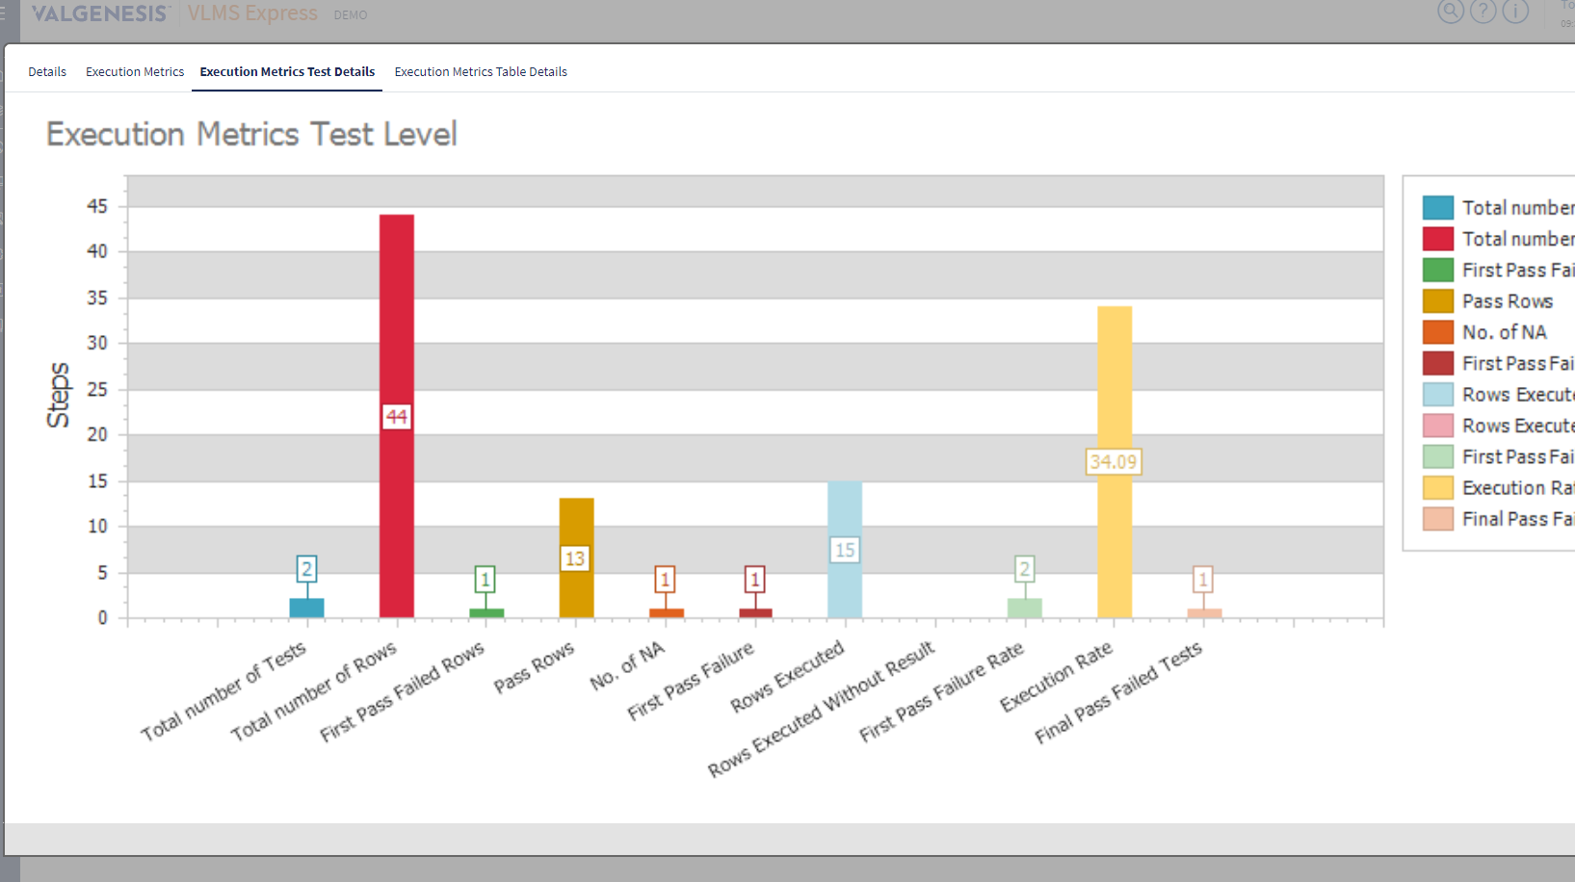
Standard and
ad hoc reporting
Notes:
Valuable reporting capabilities within the system without needing to export the data.
Although, you can export for other reporting needs.

Slide 15
VLMS vs. VLMS Express

Slide 16

Distinction from full VLMS Platform
 | VLMS Express | VLMS
Single tenant | X
Multi-site support | X
Decision Tree Risk Mgmt* | X
Change Control Requests | X
Mutli-language support | X
Single Sign On (SSO) support | X
API Integration support | X
* Planned in future release
Notes:
As robust as Express is with its capabilities…VLMS remains THE de facto standard in Validation software.
But how does Express differ from our flagship VLMS product? The primary differences lie in the number of management modules that make the full VLMS product the most comprehensive solution in the market.
Where does Express make sense?
Express is designed for single site projects, reducing the configuration necessary to assign roles and variations of templates.
Currently, the decision tree logic that resides in full VLMS that guides the author to assign the correct level of required validation is not available in Express, and is planned in a future release (TBA)

Slide 17
Designed for

Slide 18


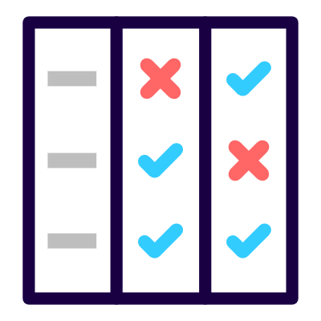
Purpose-built digital validation for CSV and more
Out-of-the-box:
Computer System
Validation
Equipment
Validation
Commissioning
& Qualification

Slide 19

Pre-market Biotech
Express can handle all your CSV, equipment, and instrument validation needs
Adherence to ALCOA+ data integrity principles
Always inspection ready
Notes:
Start digital, stay digital.
Validate your equipment, instruments, facilities and computer software
Adherence to ALCOA+ data integrity principles
Always audit and inspection ready with a few clicks
Express implements a secure, durable validation technology that helps to eliminate the frustrations that impact your time to patient.
Provide device specific validation packages, in a convenient digital format.
Leveraging a best-in-class, easy to deploy CSV solution
Clear, organized and fully digital records to simplify audits, inspections and any due diligence.

Slide 20
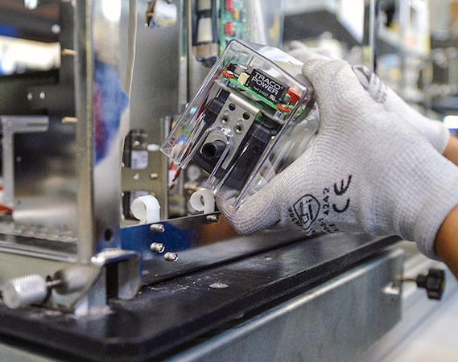
Mid-Sized Med Device Mfg
Secure, durable validation technology
Eliminate impacts on time to patient
Stand out with elegant digital validation packages
Digital, compliant CSV
Notes:
Start digital, stay digital.
Validate your equipment, instruments, facilities and computer software
Adherence to ALCOA+ data integrity principles
Always audit and inspection ready with a few clicks
Express implements a secure, durable validation technology that helps to eliminate the frustrations that impact your time to patient.
Provide your clients device specific validation packages, in a convenient digital format.
Leveraging a best-in-class, easy to deploy CSV solution
Clear, organized and fully digital records to simplify audits, inspections and any due diligence.

Slide 21

Medical Software
Fully digital CSV solution
Simplify audits, inspections and due diligence
Provide digital validation packages
Notes:
Start digital, stay digital.
Validate your equipment, instruments, facilities and computer software
Adherence to ALCOA+ data integrity principles
Always audit and inspection ready with a few clicks
Express implements a secure, durable validation technology that helps to eliminate the frustrations that impact your time to patient.
Provide device specific validation packages, in a convenient digital format.
Leveraging a best-in-class, easy to deploy CSV solution
Clear, organized and fully digital records to simplify audits, inspections and any due diligence.

Slide 22
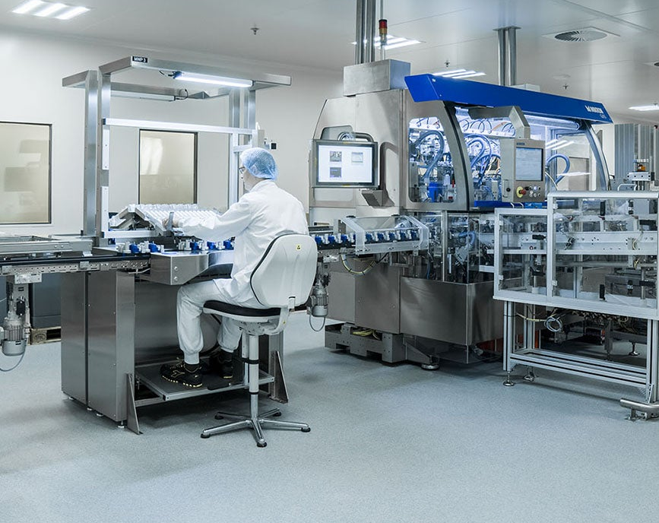
Capitalized Projects
Maximize project budget
Deploy quickly
Retain the data
Control your costs
Ensure inspection readiness
Notes:
Start digital, stay digital.
Validate your equipment, instruments, facilities and computer software
Adherence to ALCOA+ data integrity principles
Always audit and inspection ready with a few clicks
Express implements a secure, durable validation technology that helps to eliminate the frustrations that impact your time to patient.
Provide device specific validation packages, in a convenient digital format.
Leveraging a best-in-class, easy to deploy CSV solution
Clear, organized and fully digital records to simplify audits, inspections and any due diligence.
Capitalized project teams:
Maximize budget utilization on your capital projects.
Controlled expense by activating Express for the project and close it once completed.
You retain all the project data, even after project closure.

Slide 23
Designed for a Variety of Scenarios…
CDMO’s, Startups, Small Orgs
Consulting Firms
Defined Capital Projects
Start Digital, Stay Digital
Be Compliant and Audit Ready
Attract talent with Modern Tools
More time to focus on other business needs
Grow into VLMS
Defined projects
Keep Client data separate and secure
Controlled Expense by Project
Rapid Deployment
Pricing Flexibility
Notes:
Supports Multi-Tenant. Multiple tenants can be created from a master URL and customer data will be segregated in different databases.

Slide 24
Simple deployment
Get up and running faster than you thought possible.

Slide 25
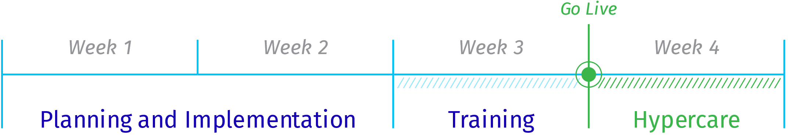

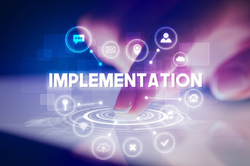


Notes:
With a pre-configured instance, VLMS Express can typically be deployed in as little as 3-4 weeks.
Try doing that with any other solution on the market!

Slide 26
Commercial Model

Slide 27
Simplified Pricing
EURO 50,000 annual fixed
Up to 30 named users
EURO 10k per additional “pack” of 10 users
Notes:
Includes 3 weeks of implementation services AND 1 week of Hypercare….these fees are waived and demonstrate VG investment into making sure you are set up for success.
6 months of VG University will also be included (access renewal process and fees TBD)

Slide 28
The value of VLMS Express

Slide 29
VLMS Express is not for ALL…But it is a good starting point
Whom
Use Case
Validation Type
Function and features
A validation Project ?
Wants to try out Digitized validation ?
Performs CSV/CSA
Performs Equipment
Performs Commissioning and Qualification
No need for Process validation
No need for Analytical method validation
Who needs a simpler user interface
No need for site specify deployment
Can use English Language Only
Data can sit in an EU and US cloud
No need for integration
No need for Life Cycle approach, but more project approach
Smaller companies ?
Single site ?

Slide 30
Up and run fast
Enjoy
benefits of Digitized Validation
Later expand your approach to Digitized Validation
Pre-configured
Handles Basic Validation needs
2-4 weeks of implementation
Cut 50% off time and cost of validation
Streamline quality
Data Integrity guaranteed
An Easy-to-use solution attract validation workforce
Expand into a Life Cycle Approach of Validation
Expand into other kinds of Validation
Expand into a more differentiated Validation

Slide 31
Our support

Slide 32
Our support
Marketing and sales material at the partner portal
Perform demos if needed
Need a quote

Slide 33
Thank You! – Any ?

