Slide 2
BROCHURE
iSEETM

Slide 3

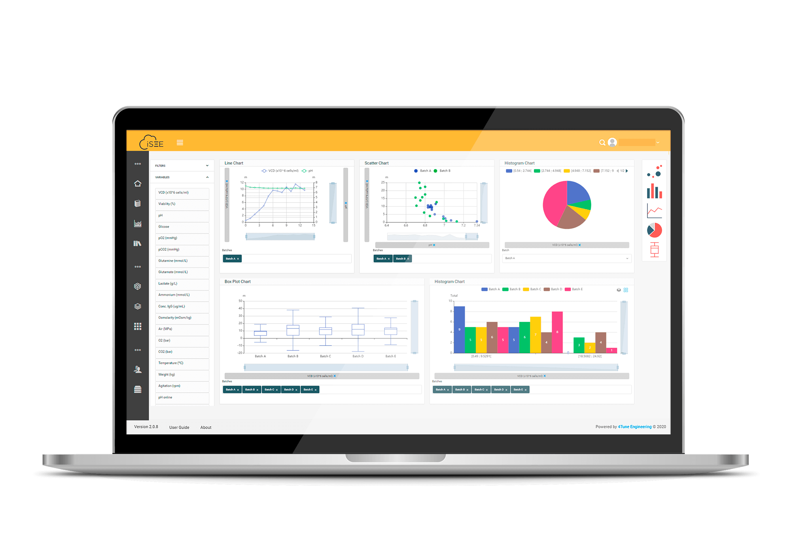
MEET iSEETM
Best-in-class Lifecycle Management requires data acquisition and visualization, advanced statistical analysis and end-to-end process monitoring.
When you work in Pharma and Biopharma, you may have very specific needs related to Process Mapping, Continued Process Verification or Process Lifecycle Management.
iSEE™ delivers it all. It combines process and product data from different sources (LIMS, SAP, MES, etc.) into a unique industry-compliant data platform with excellent reporting capabilities.
And all of this in a user friendly web-based platform, easy to use and one that requires low implementation effort.

Slide 4



BENEFITS CAPTURED THROUGHOUT THE ORGANIZATION
YOUR PROCESSES, ONE PLATFORM
iSEE™ drives horizontal integration through process mapping and end-to-end analysis and vertical integration by aggregating the history of lifecycle management. This means visibility and to be able to manage your entire product pipeline and commercial portfolio.
THE FULL PACKAGE
iSEE™ captures and accedes any type of process data. It will be analysed, used for process monitoring and to generate insights for decision-making. The centralisation of data provides experience & knowledge to support process/product design, root-cause analysis and continuous improvements.
ONE SIZE DOES NOT FIT ALL
iSEE™ is your solution. We want you to be able to choose the features that make sense to your business so that iSEE™ is tailored to best fit the needs of your organisation.
Notes:
BENEFITS CAPTURED THROUGHOUT THE ORGANIZATION

Slide 5







VISUALIZATION OF DATA & INFORMATION
MODELS & ALGORITHMS WORKFLOW
COLLECTING & AGGREGATING DATA
IRISKTM
INTEGRATION
READY
Multi-Product Portfolio Management;
Product Lifecycle Management;
End-to-End process mapping with data integration and aggregation;
Process Monitoring and Supervision;
Workflows for establishing a CPV program;
Workflows for comparability assessments;
Different user permissions;
Easy Machine learning modelling;
Import historical models for a new tool;
Information and issues gathering from all users.
FULLY CONFIGURABLE AND CUSTOMIZABLE
RELATIONAL
DATA MODELS

Slide 6
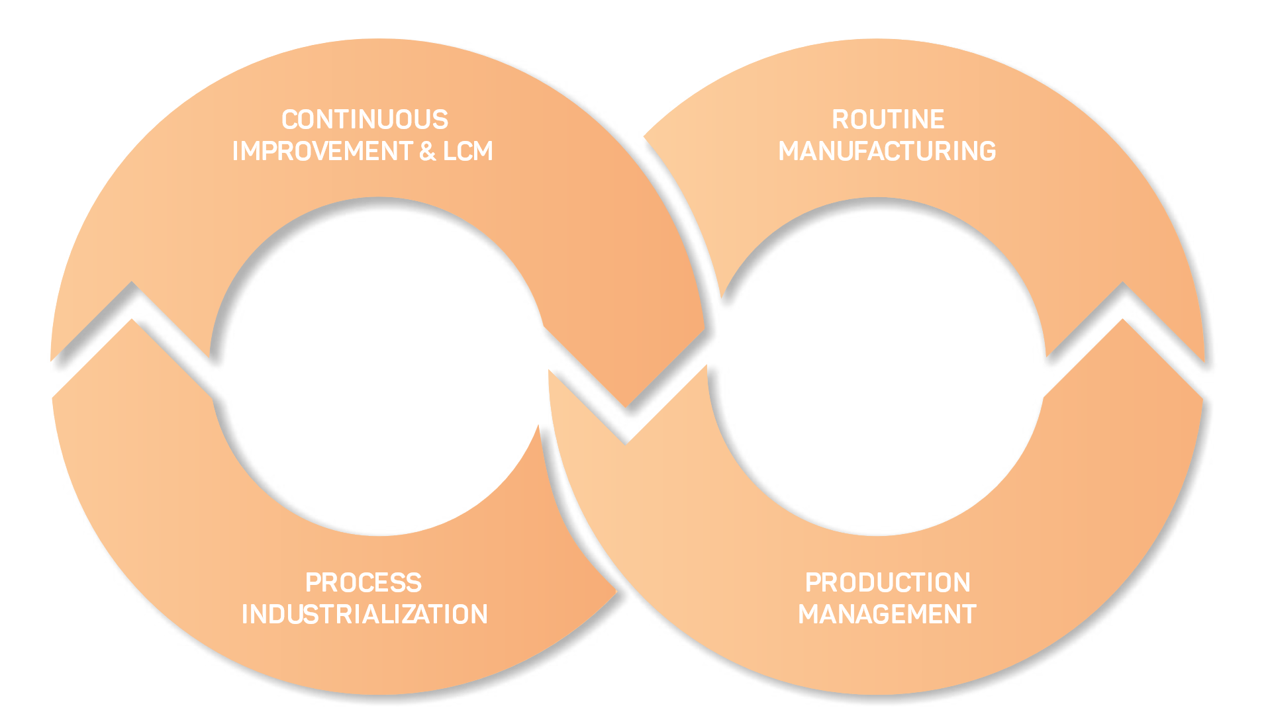
TURN INFORMATION INTO KNOWLEDGE AND KNOWLEDGE INTO ACTIONS
Site-Transfer Support
Process Troubleshooting
Monitoring Programs
Model Maintenance
Process Analytical Technologies (PAT) Multivariate Predictive Supervision
Customized Dashboards
Advanced Performance Monitoring
Scale Transfers (Up or Down)
Characterization Studies
Monitoring & Control
Knowledge-Base & Sharing
Multiple Lines & Sites
Comprehensive Audit Trail
Issues Management and Follow-Up
Historians Leverage

Slide 7

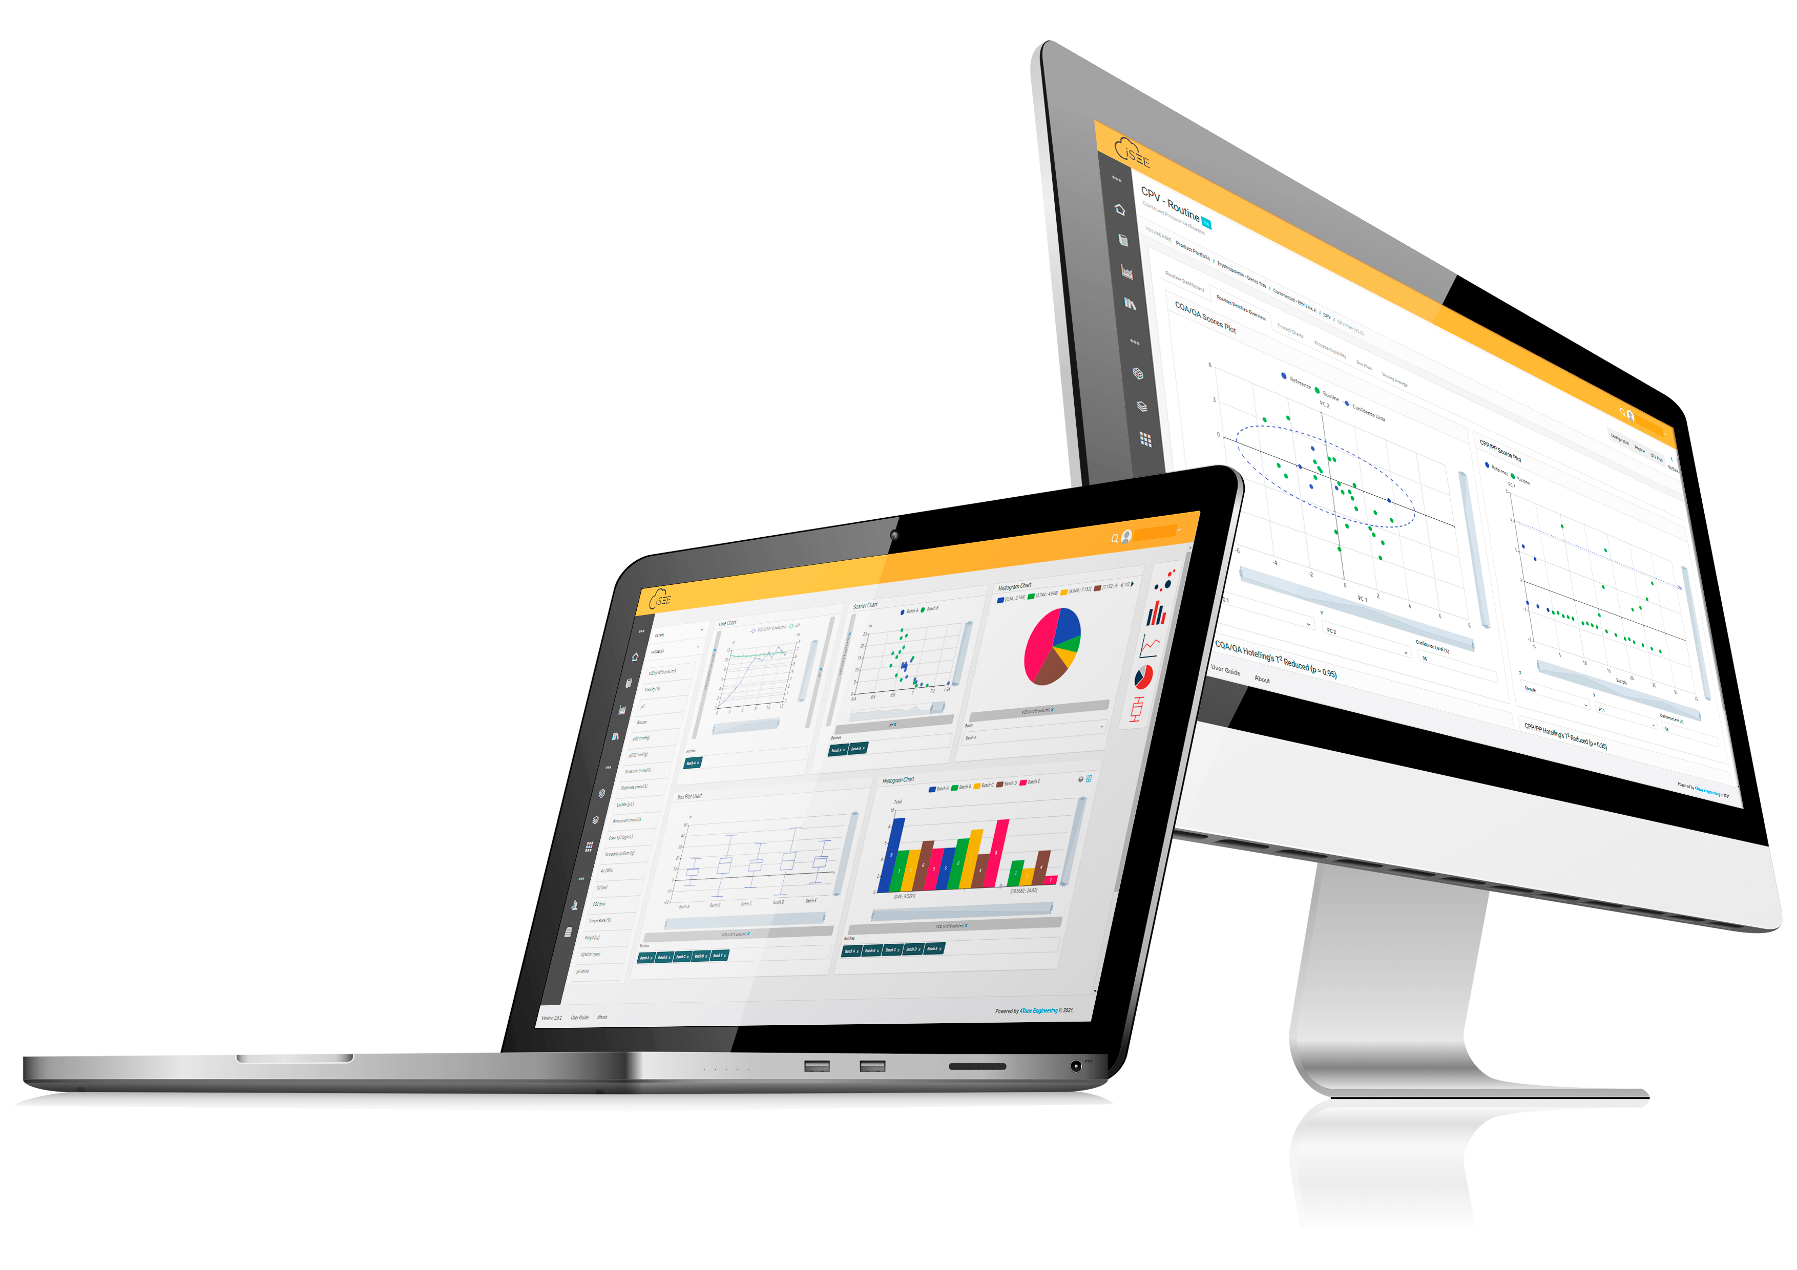
Thank you and your team so much for the great work on the iSEE™ project! The combined IT and bioengineering knowledge is really great as you had a good understanding of our processes
Manager Development Recovery and DSP,
Large Biopharma Company,
Germany.

Slide 8



CUSTOMIZABLE
We will customize the functionalities of your iSEE™ platform to address your organization’s unique requirements. This will enhance your team’s performance.
DATA INTEGRITY
We will assure the integrity of your data so that it remains an asset in the manufacture of your products. We will load your historical data, batch records, SOPs, and templates into iSEETM so that you only get the benefits of adopting a new tool with no data losses.
AUDIT TRAIL
iSEETM's audit log records all changes, the time of the event, the person causing the event and respective role, so you may be aware what is happening within your process.

Slide 9

WHAT IS INSIDE iSEETM

Slide 10






WHAT IS INSIDE iSEETM
CORE FUNCTIONALITIES
iSEE™ is modular. It has a set of core modules and another set of additional modules that can be added according to your needs.
The core functionalities are the base of the platform translated in the following modules.

Slide 11

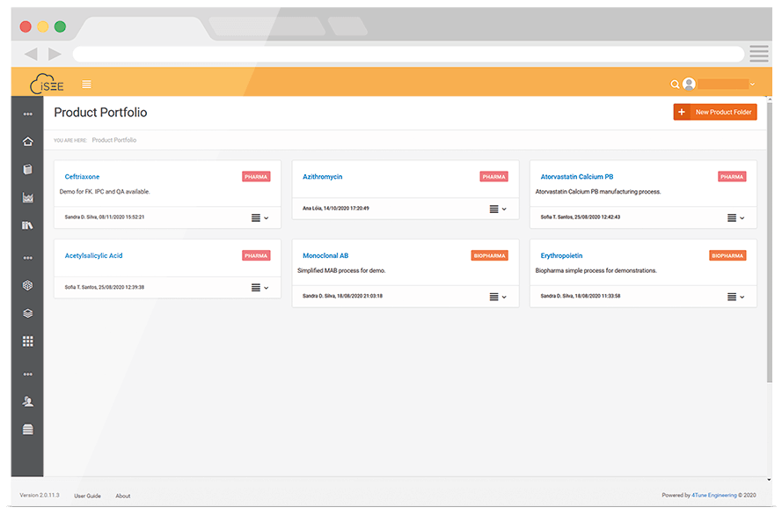
CORE FUNCTIONALITIES
PRODUCT
PORTFOLIO
Boost product development by harnessing the power of your data
Manage all of the available products in the pipeline.
Check all the active alarms, models and deviations in your dashboards.
Control the workflows, process versions and the respective process mapping, for each product.
Monitor the input and output variables for each unit operation.

Slide 12
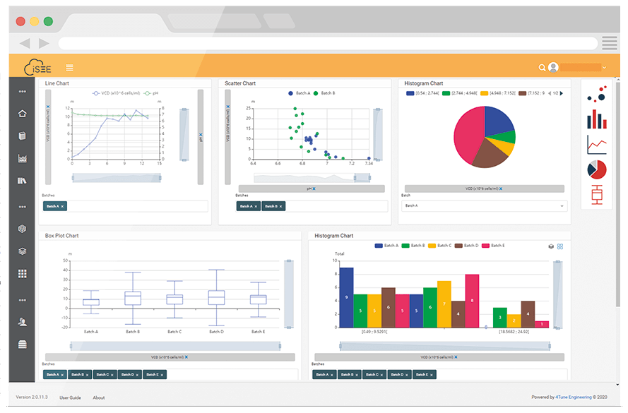
CORE FUNCTIONALITIES
VISUALIZATION
Gain quick, solid insights into your process
Interact with your data using rich and comprehensive graphic visuals
Analyse your historical data, monitor process parameters and product quality, and manage your models
Compare your process versions side by side
Easy drag and drop of process and quality data to build a variety of graphic visualizations

Slide 13
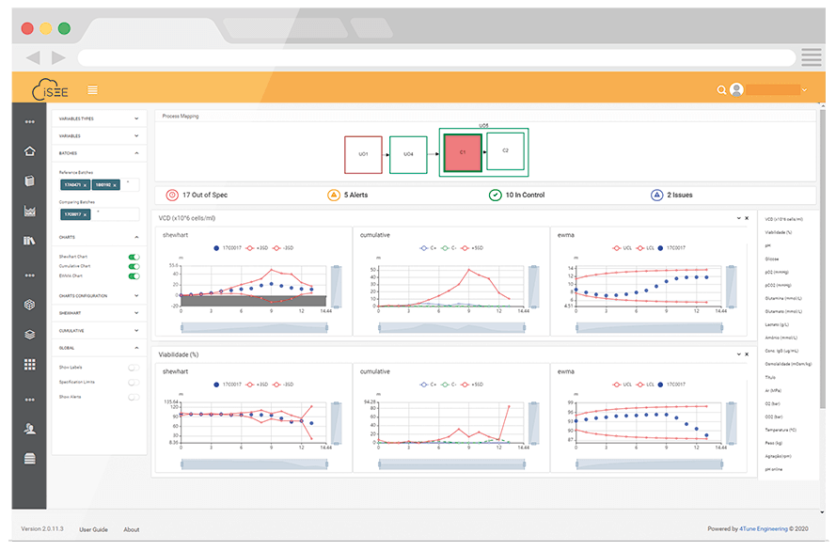
CORE FUNCTIONALITIES
MONITORING
Know what is happening when it is happening
Follow your running batch with live data trends
Identify out of specification points using SPC charts(Shewhart and Cumulative Sum). Proprietary metrics are provided to evaluate trends and deviations
Use MSPC with golden batch data as reference and predict quality attributes in real-time
Understand your business performance with effective Statistical Control Charts

Slide 14
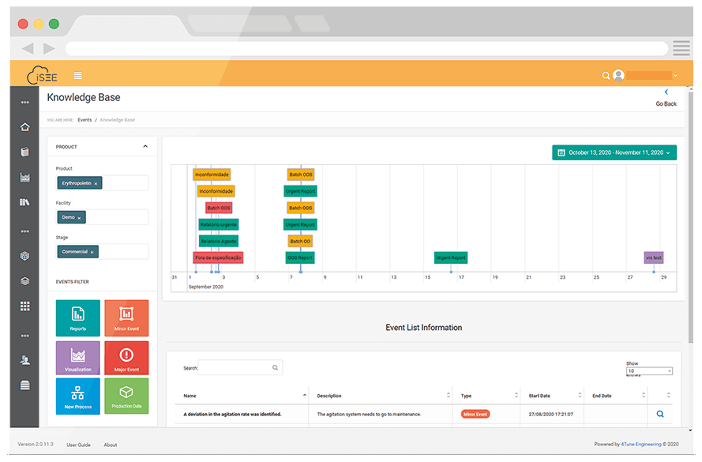
CORE FUNCTIONALITIES
KNOWLEDGE BASE
Always find what you need when you need it
Find what you need whether you are searching or scrolling down the timeline in a smart and collaborative way.
Search through all the explicit and tacit knowledge acquired throughout your product lifecycle.
Maintain a repository of scientific papers, notes and other external documents that support your data analysis and decision-making.

Slide 15
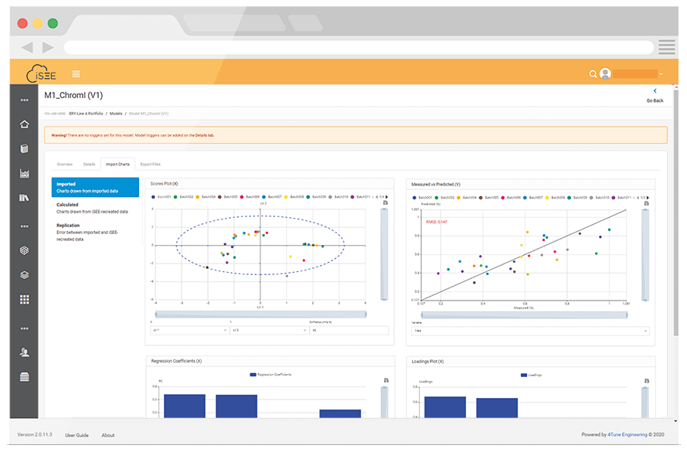
CORE FUNCTIONALITIES
MODELS
Seamlessly import your current models
Perform live monitoring and predictions using our model import tool
Choose the best option for you with either File Upload (single file with model information) or Upload Wizard (step by step data import)
Read PCA, PLS and MLR models
Manage the lifecycle of your models

Slide 16
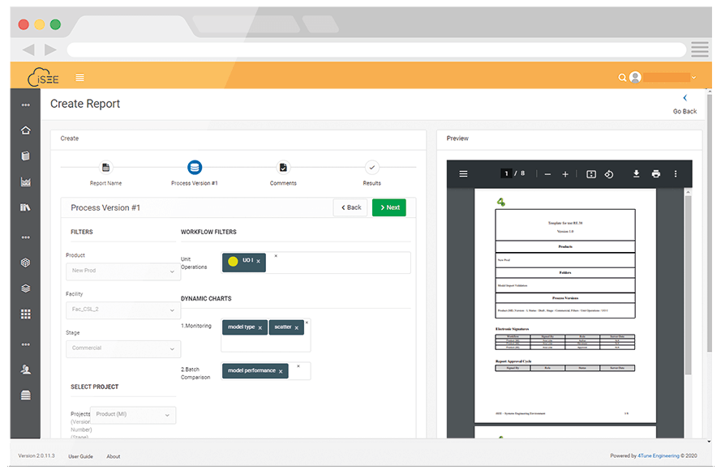
CORE FUNCTIONALITIES
REPORTS
Creating reports was never this easy
Create automatic reports for all process changes and major events.
Customize and share your reports with whoever you want.
Trace all your versions and document approval cycles.
Manage the whole process with a user-friendly report wizard.

Slide 17



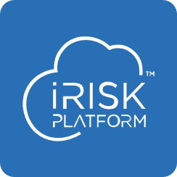

WHAT IS INSIDE iSEETM
UNIQUE & ADVANCED FUNCTIONALITIES
Unique & advanced functionalities allow the expansion of the use of iSEETM in specific areas, according to the client needs. This modularity is a flexibility enabler, as it allows clients to plug and play additional modules if and when required.

Slide 18
UNIQUE & ADVANCED FUNCTIONALITIES
DIGITAL TWIN
PAT ENGINE
Calibration made easy
All the benefits of PAT and none of the concerns
Explore your data with our preliminary analysis and outlier removal.
Develop the best PCA and PLS callibration models with our machine learning System.
Perform data import, preliminary exploratory data analysis, model calibration and validation.
Run model diagnostics by monitoring performance metrics.
Perform PAT data analysis, such as Spectra Visualization and Spectral Outlier Removal.
Investigate possible Spectral Outliers using PCA Analysis and/or Mahalanobis Distance.
Implement on-going performance verification workflows.
Define a Management System for spectral quality test deviation and respective Mitigation Actions.

Slide 19
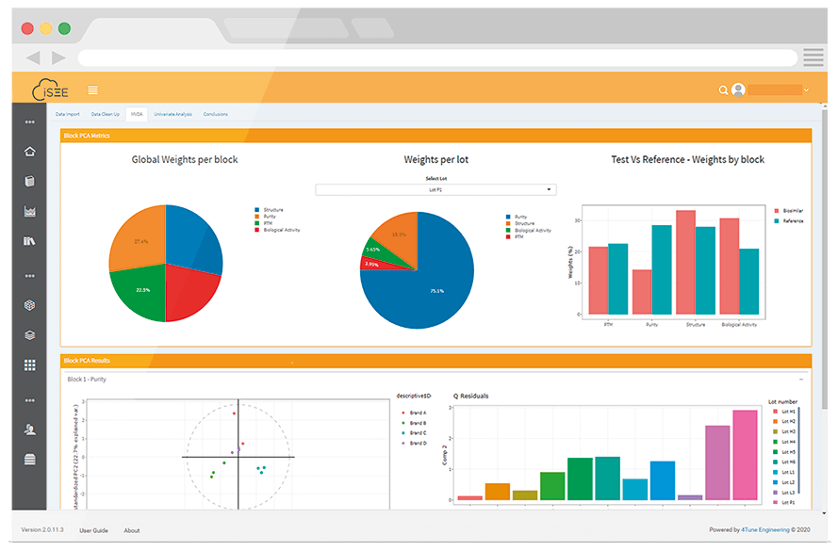
UNIQUE & ADVANCED FUNCTIONALITIES
COMPARABILITY TOOL
Never be afraid to make changes to your processes
Perform comparability exercises, using both traditional and innovative approaches.
Compare your processes using Multivariate Comparability based on the FDA’s fingerprint-like concept.
Take control of your Charts and Hypothesis testing.
Apply it in Biosimilarity Assessments, Scale-Up operations and changes over lifecycle (equipment, process, unit operations, product).

Slide 20
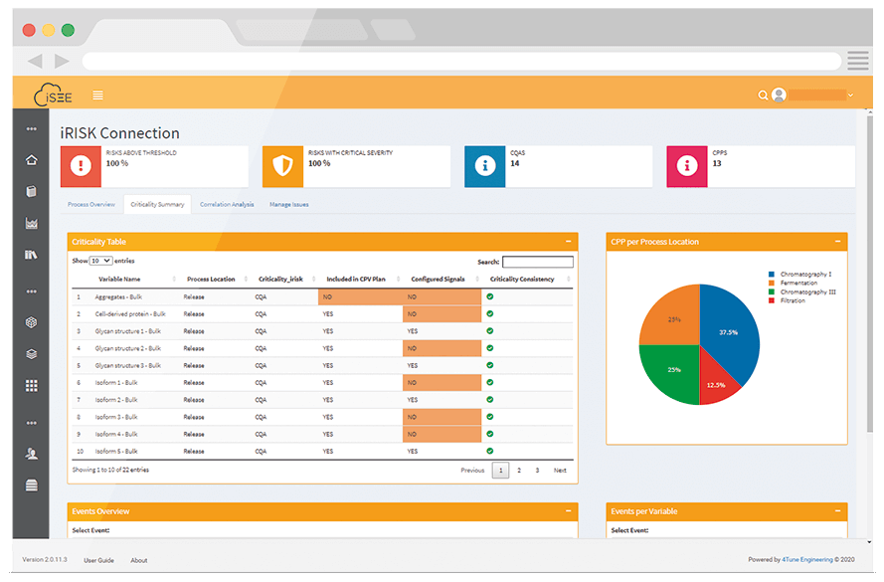
UNIQUE & ADVANCED FUNCTIONALITIES
iRISKTM
Bring together the data from iRISK™ and iSEE™
Associate monitoring metrics to the inputs related to each failure mode.
Verify which UO has a higher number of risks and deviations.
Calculate correlation matrices and compare the results with CEMs and corroborate their scores with data evidence.
Perform root-cause analysis in iRISK™ to facilitate troubleshoot activities developed in iSEE™ and migrate statistical data from iSEE™ to support risk assessments in iRISK™.

Slide 21
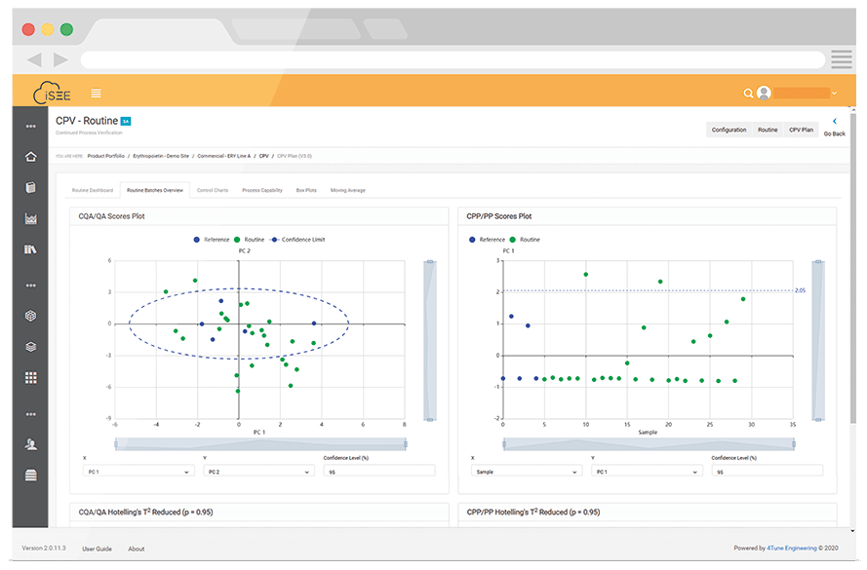
UNIQUE & ADVANCED FUNCTIONALITIES
CPV
Keep your process in a State of Control
Perform multivariate analysis for an easier and more efficient selection of CPV/OPV Reference Batches, remove critical process parameters and critical quality attributes.
Accede to Risk Assessments to evaluate criticality of process parameters and quality attributes.
Support the creation of Control Charts and Process Capability Analysis with Several Statistical Tools.
Use the Decision-Tree tool to describe Mitigation Actions as a Response to Statistical Signals.

Slide 22

ALL IN ONE PIECE

Slide 23

Accelerate Product
development
Interactive database
Query for visualizations
Real time
SPC
Information timeline
view
Model import from
different platforms
Comparability tools
for product, process and changes over LC
PAT framework for model and tool lifecycle management
Dedicated MVDA
workflow for CPV
Easy Machine
Learning Models
Integrated Risk
analysis tools

Slide 24
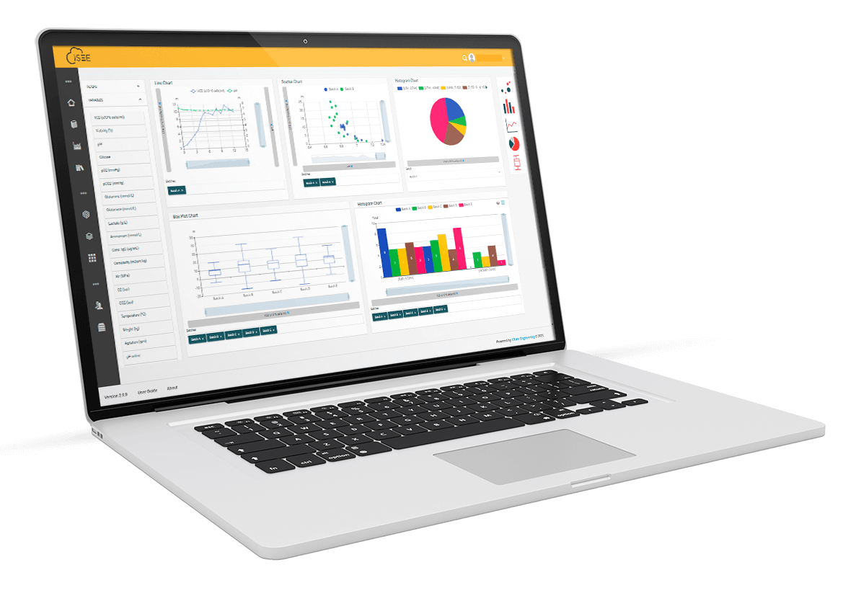
iSEE™ supports pharma and biopharma companies on Industry 4.0 transition. On top of all the existing available functionalities and modules, 4TE believes that flexibility is a key-success factor for platform implementation in a corporate environment. In this context, iSEE™ is both configurable and customizable for an enhanced fit to client’s requirements, ensuring business added value.

